Slide 1
ITIL® 2011 Foundation Certification Course
Unit 1—Introduction to Service Management Lifecycle

Slide 2
Introduction to Service Management Lifecycle
Lesson 1—Principles of IT Service Management

Slide 3
Objectives
Explain the best practices in IT Service Management
Identify the stakeholders in service management
Describe service management roles and responsibilities
Explain the types of service providers
After completing this lesson, you will be able to:

Slide 4

IT Service Management—Best Practices
IT Service Management is the implementation and management of quality IT services that meet the needs of a business. It includes best practices followed by many organisations. The sources of best practices are:
Existing public standards published by the International Standards Organisation or ISO;
Industry practices that are shared among industry practitioners;
Academic research; and
Internal experiences or an organisation’s past experiences in providing similar services.

Slide 5
Public and Proprietary Practices
The table provides a comparison between public and proprietary practices.
Public practices | Proprietary practices
Widely distributed through public training and certification. | Deeply embedded in organisations.
Applied across various technologies and businesses. | Highly customised to serve specific business needs.
Available for free. | Owners expect compensation.
Organisations can hire people with the knowledge of such practices. | The evolution of such practices depends on the owner and cannot be guaranteed.

Slide 6
Which of the following is true for public practices?
Public practices need you to pay
The evolution of public practices depends on the owner
Public practices are customised to suit business requirements
Public practices are applied across multiple businesses and technologies

Slide 7
Which of the following is true for public practices?
Public practices need you to pay
The evolution of public practices depends on the owner
Public practices are customised to suit business requirements
Public practices are applied across multiple businesses and technologies
Answer: d.
Explanation: Public practices are applied across various organisations and technologies.

Slide 8



Service—Introduction
Service is a means of delivering value to customers by facilitating outcomes the customers want to achieve, without the ownership of specific costs or risks.
Customer—Online bookstore
Transfers the responsibility to manage risks and costs
Value added by service provider
Performs tasks
Manages risks and constraints
Optimises costs
Service provider—Database solutions

Slide 9
Service Management
Service management is the effective, process-driven management of transforming IT resources into valuable IT services.
Capabilities
Performance
Value
Business outcomes
Service assets
Services
Customer assets
Resources
Service management
© Crown Copyright 2011. Reproduced under licence from AXELOS.

Slide 10
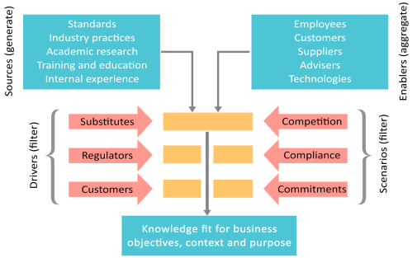
Service Management Practice
The image shows the various sources, enablers, drivers and scenarios of service management practice.
© Crown Copyright 2011. Reproduced under licence from AXELOS.

Slide 11

Challenges in Service Management
Following are the challenges in service management:
The nature of output is intangible.
The output is hard to control, measure and validate.
Demand is associated with customers’ assets.
There is hardly any buffer between the creation of the service and its consumption.
Service capacity and output are perishable by nature.

Slide 12
Benefits of IT Service Management
Following are the benefits of IT Service Management:
Quality service provision
The service quality is cost-effective
Services satisfy customer, user and business demands
Centralised and integrated processes

Slide 13




Stakeholders in Service Management
Stakeholders are those entities who are interested in the outcome of a service or a project. Following are the stakeholders in service management:
Organisation refers to a legal entity, a company or an institution that comprises resources, people and budgets. An example of temporary organisation is project and that of a permanent organisation is business.
Organisation
Internal stakeholders are the groups, teams and functions that deliver services within a service provider organisation.
Internal stakeholders
They are customers buying goods or services, end users of services, and third parties such as suppliers who provide the goods or hardware and network service for IT service delivery.
External stakeholders

Slide 14
Internal and External Customers
For any organisation, there are two types of customers as mentioned below:
Internal customers
External customers
They work in the same organisation as the IT service provider.
Example: The marketing department in an IT company is its internal customer because it uses IT services.
Purchase services from the service provider under a legal contract, and are not employed by the organisation.
Example: An online book seller getting IT services from an IT service provider is an external customer.

Slide 15
Internal and External Services
Internal and external services are defined below:
These are services delivered to business units within the same organisation.
Internal service
These are services delivered to an external organisation.
External service

Slide 16
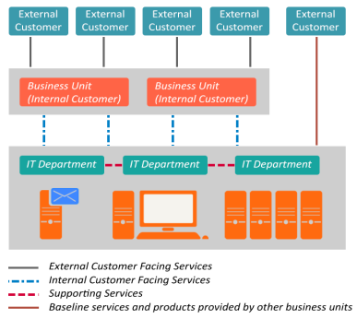
Internal and External Services (contd.)
The image shows that the IT department provides services to business units which belong to the same organisation. Such services are known as internal services. For example, the sales department is an internal customer using the CRM services provided by the IT department.
The same IT department provides services to the customers who are external to the organisation. These services are called external services.
© Crown Copyright 2011. Reproduced under licence from AXELOS.

Slide 17


Internal and External Services (contd.)
Given below are the facts related to internal and external services:
Internal service
External service
Supports activities within an organisation.
These services result in business outcomes.
Linking the internal services to the external services helps in measuring the outcomes and the ROI or Return on Investment.

Slide 18
Process
A process is a set of activities designed to accomplish a specific objective. It takes defined inputs and turns them into defined outputs. A process may include roles, responsibilities, tools and management controls required to deliver the outputs.
Process control
Process owner
Process policy
Process objectives
Triggers
Process documentation
Process feedback
Process
Process activities
Process metrics
Process improvements
Process inputs
Process outputs
Process procedures
Process roles
Process work instructions
Process enablers
Process resources
Process capabilities

Slide 19



Process Characteristics
Following are the common characteristics of all processes:
The cost, quality and other variables of a process can be measured.
A process leads to a specific result for stakeholders and customers.
A process responds to triggers or events.

Slide 20
Functions Related to Service Management
Functions consist of a team of people and the tools they need to carry out one or more processes or activities. They are the units of an organisation, which specialise in performing certain types of work. Functions are responsible for specific outcomes.
The functions related to service management are:
Service desk
IT operations management
Technical management
Application management

Slide 21
Functions Related to Service Management (contd.)
Following are the facts related to the various functions associated with service management:
Service desk: It is the single point of contact where the business sends operational requests and customers make support or service requests.
IT operations management: It includes activities related to IT service delivery and the control and maintenance of IT infrastructure. It comprises the following:
Operations control: It includes job scheduling, backup and restore procedures and processing of console management.
Facility management: It is related to managing the physical IT environment such as network rooms, data centre rooms and power supply.

Slide 22
Functions Related to Service Management (contd.)
Following are the facts related to the other functions in service management:
Technical management: It designs cost-effective technological infrastructure to support business processes. This team is involved in testing and optimizing IT services, and provides resources to support the ITSM lifecycle.
Application management: It helps to manage applications for their lifecycle and provides resources for the ITSM lifecycle. This team plays a key role in designing, testing and improving applications.

Slide 23
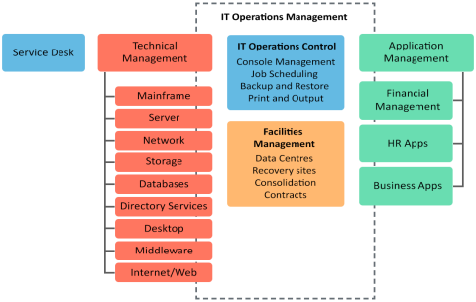
Functions Related to Service Management (contd.)
The image shows the functions related to service management, as defined by ITIL® 2011.
© Crown Copyright 2011. Reproduced under licence from AXELOS.

Slide 24
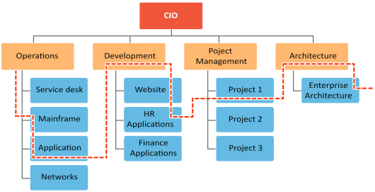
How Processes and Functions Operate
A process-oriented organisation aligns processes across functions. This helps the functions to run effectively, resulting in customer satisfaction. In the image, the functions like operations, development, etc., and their sub-functions follow a single process which is indicated by a dotted line.

Slide 25


Roles in Service Management
Two key roles in service management are the Service Owner and the Process Owner.
Service Owner is the person who is accountable for the delivery of a specific IT service, They are responsible for continual improvement and management of change affecting services under their care.
Service Owner
The Process Owner is responsible for ensuring that a process is being performed as agreed and documented.
Process Owner

Slide 26

Roles in Service Management (contd.)
Following are the responsibilities of the Service Owner:
Handles service enquiries and issues.
Identifies opportunities for service requirements.
Maintains liaison with the process owners.
Solicits the reports, statistics and other data required for analysis.
Ensures effective service monitoring and performance.

Slide 27

Roles in Service Management (contd.)
Following are the main responsibilities of the Process Owner:
Documents and publishes the process.
Defines the Key Performance Indicators or KPIs.
Engages in process design and takes responsibility for it.
Reviews any proposed enhancement to the process.
Addresses any issue related to the way the process runs.

Slide 28
Roles in Service Management (contd.)
Following are other responsibilities of the Process Owner:
Ensures that the staff has the required training in the process and are aware of their roles in it.
Ensures that processes, roles, responsibilities and documents are regularly reviewed and audited.
Interfaces with the line management and ensures that the process receives the needed staff resources.

Slide 29
RACI Model
The RACI model is used to identify the following roles and responsibilities in a process:
Responsible
Includes the people or person responsible for carrying out various tasks.
Accountable
Includes one person taking ownership and being accountable for various activities.
Consulted
Comprises the people whose opinions are sought after designing, implementing or improving an activity.
Informed
Includes the people who are informed while executing or improving an activity.
There can be only one person accountable but multiple people responsible for an activity.

Slide 30
RACI Model (contd.)
The table shows the RACI model based on the roles and responsibilities related to activities in a process.
Activities | Service Owner | Process Owner | Security Manager | IT Head | Chief Architect | Process Manager
Create a framework for defining IT services | C | C | C | A/R | C | I
Build an IT service catalogue | C | A/R | I | C | I | I
Define SLA for critical IT services | A | R | C | R | C | I
Monitor and report SL performance | I | A/R | I | I | I | R
Review SLAs, OLAs and UCs | A | R | C | R | I | R
Review and update IT service catalogue | C | A/R | I | C | I | C
Create a service improvement plan | I | A/R | I | C | C | R

Slide 31
Types of Service Providers
According to ITIL®, an IT service provider is an organisation supplying IT services to one or more internal or external customers. ITIL® defines three types of service providers:
Type I or internal
Refers to a service provider embedded within a business unit.
Example: An IT organisation within each business unit
Type II or shared
Refers to an internal service provider that offers shared IT services to more than a single business unit.
Example: A telecom company’s IT services team offering services to the mobile and landline phone units of the same company
Type III or external
Refers to an external service provider that offers IT services to external customers.
Example: An IT service provider in India, which offers outsourcing services to a global bank

Slide 32
Supplier and Legal Agreements
Following are the three key terms associated with IT Service Management:
Third party responsible for supplying goods or services required to deliver IT services. Commodity software and hardware vendors, outsourcing organisations and telecom and network providers are suppliers.
Supplier
Underpinning contract
It is a legal agreement between the service provider and the supplier.
The agreement between the business organisation and the IT service provider is called Service Level Agreement.
Service Level Agreement

Slide 33
Who defines the key performance indicators in service management?
Service Owner
Service provider
Internal stakeholder
Process Owner

Slide 34
Who defines the key performance indicators in service management?
Service Owner
Service provider
Internal stakeholder
Process Owner
Answer: d.
Explanation: The Process Owner defines the key performance indicators in service management.

Slide 35
Summary
Best practices are successful innovations that have been accepted and followed by organisations.
Service management helps to transform IT resources into valuable IT services.
Stakeholders are interested in the target, resources, activities and outcome of a service or a project.
The Service Owner is responsible for providing a specific service within an organisation. The Process Owner ensures that a process is performed as decided and documented.
Here is a quick recap of what we have learnt in this lesson:

Slide 36
Introduction to Service Management Lifecycle
Lesson 2—The Service Lifecycle

Slide 37
Objectives
Identify the components or phases of service management lifecycle
Explain the relationship between governance and ITSM
After completing this lesson, you will be able to:

Slide 38
Components of Service Management Lifecycle
Following are the components or phases of service management lifecycle.
Application Management
Design Coordination
IT Operations Management
Supplier Management
Change Evaluation
Technical Management
Information Security Management
Service Validation and Testing
Service Management
Strategy Management
IT Service Continuity Management
Knowledge Management
Access Management
Business Relationship Management
Availability Management
Release and Deployment Management
Problem Management
IT Financial Management
Capacity Management
Service Asset and Configuration management
Incident Management
Service Portfolio Management
Service Catalogue Management
Change Management
Request Fulfilment
Demand Management
Service Level Management
Transition Planning and Support
Event Management
Service Strategy
Service Design
Service Transition
Service Operation
Continual Service Improvement
7 Steps Improvement Process, Deming Cycle, CSI model
Service Reporting
Service Measurement
© Crown Copyright 2011. Reproduced under licence from AXELOS.

Slide 39
Components of Service Management Lifecycle (contd.)
Below are the facts related to the components or phases of service management lifecycle:
Service strategy
The organisation decides to come up with certain services to have a competitive advantage in the market.
Questions like what service to provide and why will someone pay for the services are addressed.
Service design
In this phase, specific design related decisions are taken.
Questions, such as what is the user base, will the services be offered 24/7 or will they be provided during a certain time period, are addressed.
Service transition
Once all service design related decisions are taken, the focus shifts to the service transition stage.
This is the stage of making the services available to the target user base.

Slide 40
Components of Service Management Lifecycle (contd.)
Below are the facts related to some more components or phases of service management lifecycle:
Service operation
When users encounter any problem while accessing the service, service operation takes care of resolving their problems.
The aim of service operation is to ensure that a service runs uninterrupted.
Continual service improvement
This phase is common to all the phases of service management lifecycle.
It includes regular monitoring of service for improvement of service quality.

Slide 41
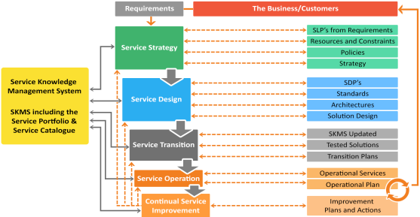
Interactions in the Service Lifecycle
The image below demonstrates the interactions in the service lifecycle.
© Crown Copyright 2011. Reproduced under licence from AXELOS.

Slide 42
Relationship between Governance and ITSM
The image below shows the relationship between governance and IT Service Management.
Corporate governance
Ensures the provision strategy and business plans. Establishes the corporate policies and enables strategic direction, objectives, critical success factors and key result areas.
Corporate compliance
Assures adherence to legal, industrial and regulatory requirements.
IT governance
Establishes IT policy, standards and principles. Assures alignment of IT strategy to corporate business strategy.
IT compliance
Assures the design and operability of IT policies, processes and key controls.
IT Service Management
Establishes, enables and executes the IT strategy. Establishes operations to assure high-quality compliant IT service provisioning. Ensures effective key result areas.

Slide 43
Summary
The five components of service management lifecycle are service strategy, service design, service transition, service operation and continual service improvement.
Continual service improvement identifies opportunities for improving the failures within any stage of the service lifecycle.
Corporate governance deals with setting up corporate policies, strategic directions, etc., and identifying critical success factors for an organisation.
IT Service Management helps to implement quality IT services that meet the needs of a business.
Here is a quick recap of what we have learnt in this lesson:

Slide 45
What is the RACI model used for?
1
Documenting the roles and relationships of stakeholders in a process
Defining the requirements for a new service or process
Analysing the business impact of an incident
Creating a balanced scorecard to show the status of service management

Slide 46
What is the RACI model used for?
1
Documenting the roles and relationships of stakeholders in a process
Defining the requirements for a new service or process
Analysing the business impact of an incident
Creating a balanced scorecard to show the status of service management
Answer: a.
Explanation: RACI model identifies which stakeholders are responsible, accountable, consulted and informed about a process.

Slide 47
The Service Owner is responsible for _____________.
2
Designing and documenting a service
Carrying out the activities related to service operations
Producing a balanced scorecard to show the overall status of services
Recommending improvements

Slide 48
The Service Owner is responsible for _____________.
2
Designing and documenting a service
Carrying out the activities related to service operations
Producing a balanced scorecard to show the overall status of services
Recommending improvements
Answer: d.
Explanation: The Service Owner recommends service improvements.

Slide 49
Which of the following statements is correct?
3
Only one person can be responsible for an activity
Only one person can be accountable for an activity
Multiple people can be responsible and accountable for an activity
Multiple people are accountable but one who takes the ownership is responsible

Slide 50
Which of the following statements is correct?
3
Only one person can be responsible for an activity
Only one person can be accountable for an activity
Multiple people can be responsible and accountable for an activity
Multiple people are accountable but one who takes the ownership is responsible
Answer: b.
Explanation: According to the RACI model, only one person accountable but multiple people responsible for an activity

Slide 51
Which of the following statements about functions is incorrect?
4
Functions provide structure and stability to organisations
Functions are self-contained units with capabilities and resources
Functions rely on processes for cross-functional coordination and control
Functions are costlier to implement compared to processes

Slide 52
Which of the following statements about functions is incorrect?
4
Functions provide structure and stability to organisations
Functions are self-contained units with capabilities and resources
Functions rely on processes for cross-functional coordination and control
Functions are costlier to implement compared to processes
Answer: d.
Explanation: Functions include a group of people or tools that help to execute processes. These are not costlier to implement compared to processes.

Slide 53
Which of the following is not the characteristic of a process?
5
It is measurable
It is timely
It delivers a specific result
It responds to a specific event

Slide 54
Which of the following is not the characteristic of a process?
5
It is measurable
It is timely
It delivers a specific result
It responds to a specific event
Answer: b.
Explanation: A process can be measured. It is result-oriented and responds to specific events. However, it may not be timely.

Slide 55
ITIL® is a registered trade mark of AXELOS Limited
IT Infrastructure Library is a registered trade mark of AXELOS Limited
AXELOS® is a trade mark of AXELOS Limited

